Slide 1

GROUP – 4 : Database Management System for UPS Deliveries IS680 Database Management Systems Sec 02 11140 - 2024
Team:
Vishakha Maruti Sonmore Saumya Chandrakant Prasad
Prithviraju Venkataraman
Bommalapura Panjaru Shashidhar Reddy Shloka Ramesh Daga

Slide 2

Who is UPS ?
United Parcel Service
A company best known for reliable, efficient package delivery, was commenting in late 2000 on how his company had become far more than a package delivery company.
For a decade, UPS had been capitalizing on opportunities created by information technology to increase the efficiency and flexibility of its core business.

Slide 3
Statement of Problem
To ensure the efficient management and timely delivery of packages to customers, a robust database system plays a pivotal role. Our presentation aims to underscore the significance of database management within a package delivery service, emphasizing the essential components of the database and its implementation to enhance customer experience and streamline business operations.
Moreover, the presentation showcases proficiency in logical and conceptual models, database design, and SQL development. At its essence, this initiative is geared towards optimizing data storage, retrieval, and analysis processes, thereby enabling UPS to operate with unparalleled efficiency and precision.

Slide 4
Objective
Approach
The primary aim of our database is to streamline and optimize the logistical operations of United Parcel Service (UPS). It needs to centralize and manage vast amounts of data related to package tracking, customer information, delivery routes, and operational performance
The database application will encompass a multifaceted approach, incorporating elements such as conceptual modeling, logical design, and a robust data dictionary.
By meticulously cataloging information ranging from customer profiles to delivery details, the system will serve as a cornerstone for UPS's operational infrastructure.

Slide 5
Inputs and Information Management
Inputs to the database encompass a wide array of data points collected throughout the logistics process. These include:
Package tracking events: Information Regarding Package Shipment, Sender, Tracking, Company, Transaction.
Customer information: Recipient, Customer.
Delivery routes and schedules: Employee, Vehicle, Warehouse, Location.
Information Stored in the Database
The database will need to store a comprehensive range of information to support UPS's logistical operations effectively. This includes:
Customer Information: Name, contact details, delivery preferences, billing information.
Package Data: Tracking numbers, sender and recipient details, package dimensions, and weight.
Operational Metrics: Delivery times, transit durations, status

Slide 6
Dictionary
1 of 3

Slide 7
Dictionary
2 of 3

Slide 8
Dictionary
3 of 3

Slide 9
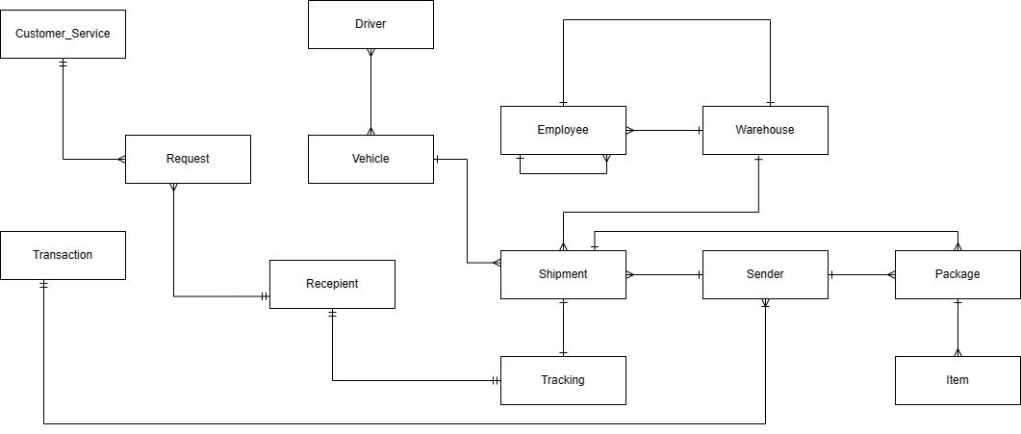
Conceptual Model

Slide 10
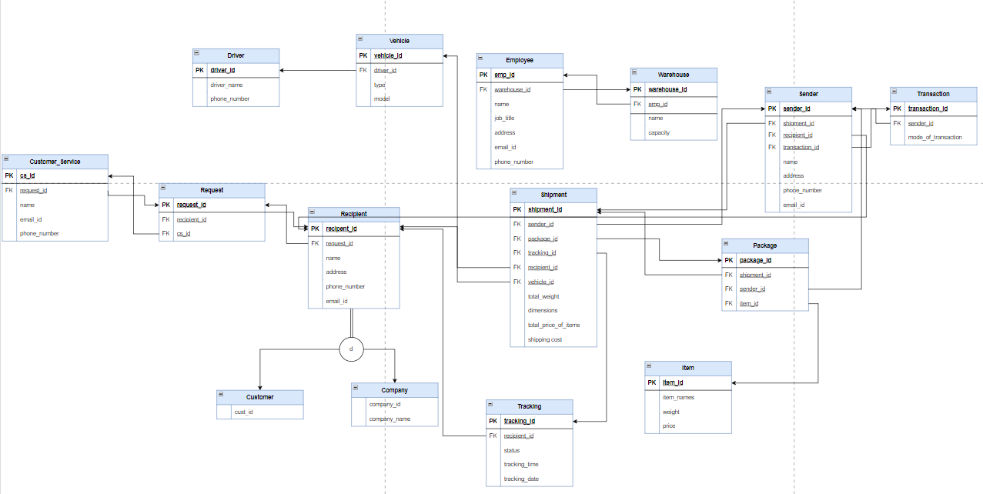
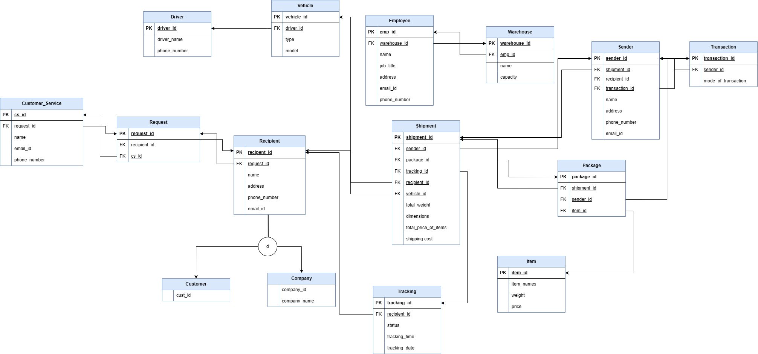
Logical Model

Slide 11
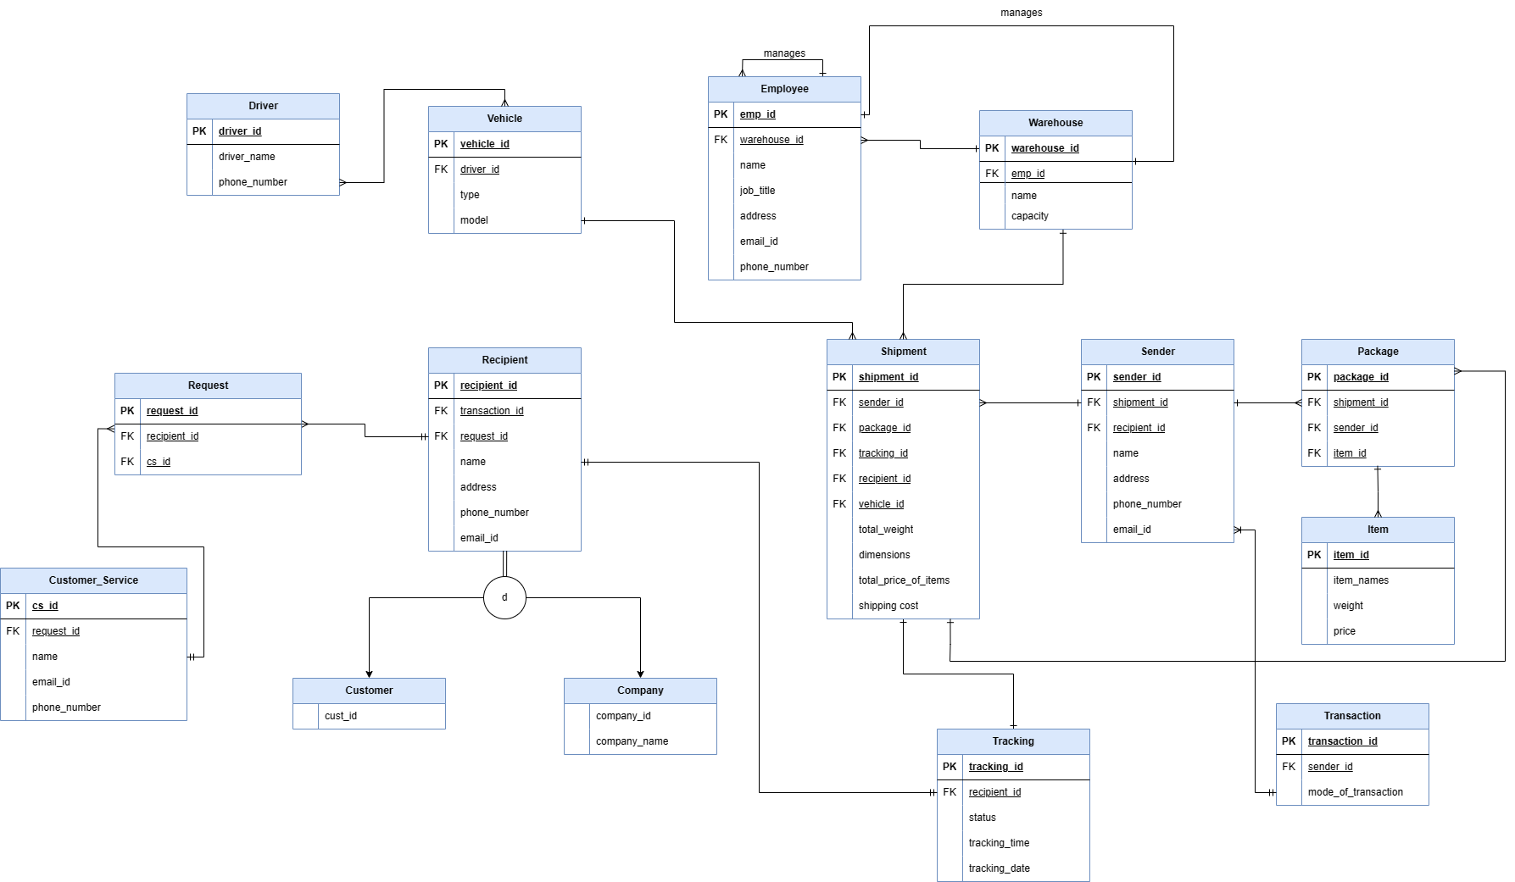
ER DIAGRAM

Slide 12
Partition and De-Normalization
Partitioning might add complexity to managing databases and their structures
It might be more effective to maintain a simple and manageable database structure if the needs of your application do not warrant the additional complexity
Partitioning may not be necessary if the data is already evenly spread across tables
Depending on your database system, partitioning may incur additional costs in terms of licensing, hardware, or maintenance
The introduction of redundancy through denormalization of the database raises the possibility of inconsistent data and update anomalies
Normalized databases store data in a structured, normalized format, reducing these risks
There's a chance that de-normalizing the database will require more storage
It's essential to carefully evaluate whether the potential benefits of denormalization outweigh the drawbacks in your specific use case

Slide 13
Database Recovery
A database recovery policy is a set of rules that an organization adheres to in order to guarantee that a process or mechanism is in place for recovering lost databases or fixing database damage.
Having backup facilities is one way of doing it.
Storage Infrastructure: Refers to systems or storage devices that are used to hold backup data. It could include cloud-based storage options as well as on-site storage servers and disk arrays.
Backup Software: Backup software controls data transfer, schedules backups, oversees the backup procedure, and aids in recovery efforts. Oracle RMAN (Recovery Manager) is one example.

Slide 14
Database Security
Data Encryption and Security: Encryption techniques can be used by backup facilities to safeguard backup data while it is being transmitted and stored, shielding it from breaches or unwanted access.
Disaster Recovery Planning: A comprehensive disaster recovery plan, which includes backup facilities, usually includes procedures for restoring data and systems in the event of a significant outage or disaster.

Slide 15
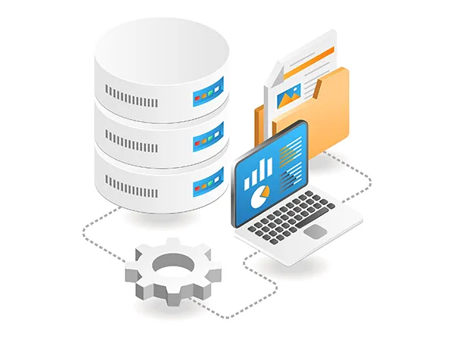
SQL Queries
SQL Queries Performed
Database operations:
Create
Read
Update
Delete
JOIN
LIMIT
DESC
ORDER BY
GROUP BY

Slide 16
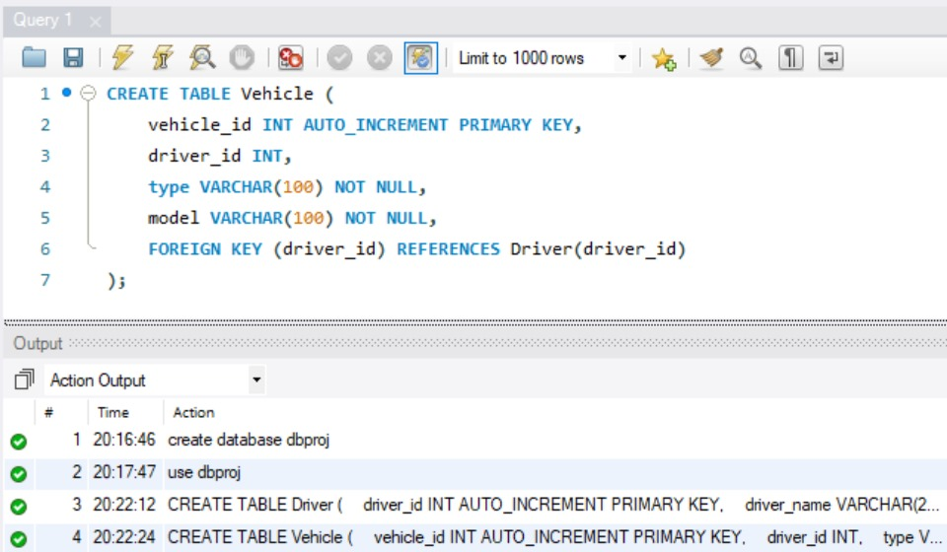
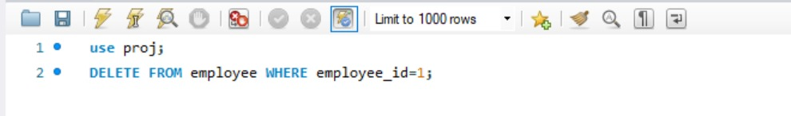
SQL Queries
CRUD Operation :
CRUD represents the four fundamental database operations:
Create
Read
Update
Delete
These operations respectively involve adding new data, retrieving existing data, modifying data, and removing data from a database.

Slide 17
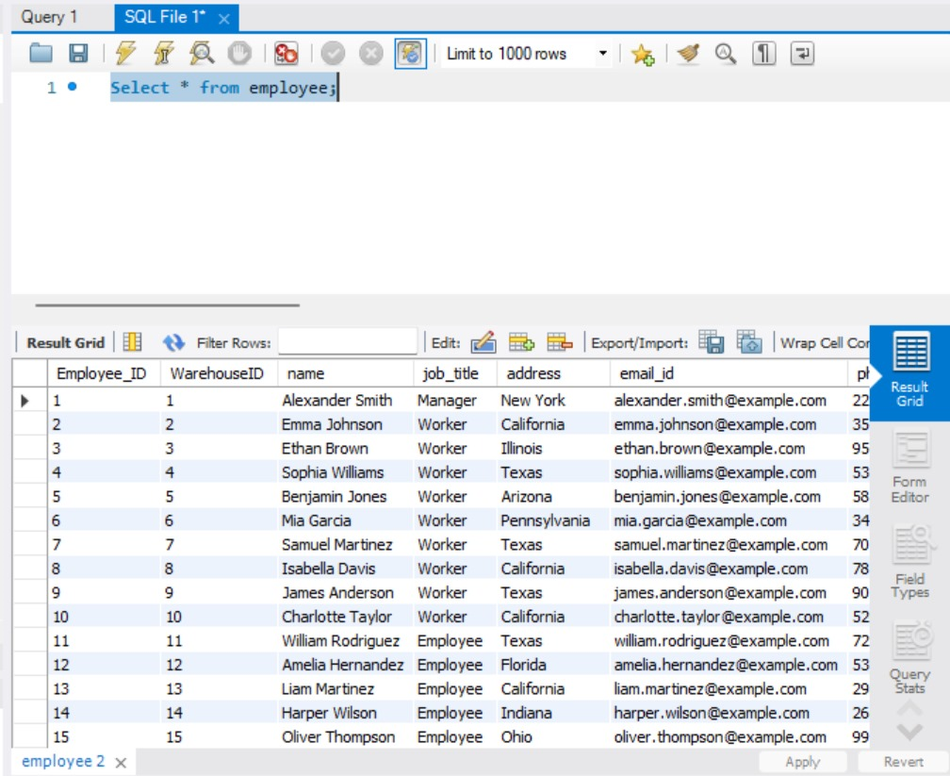
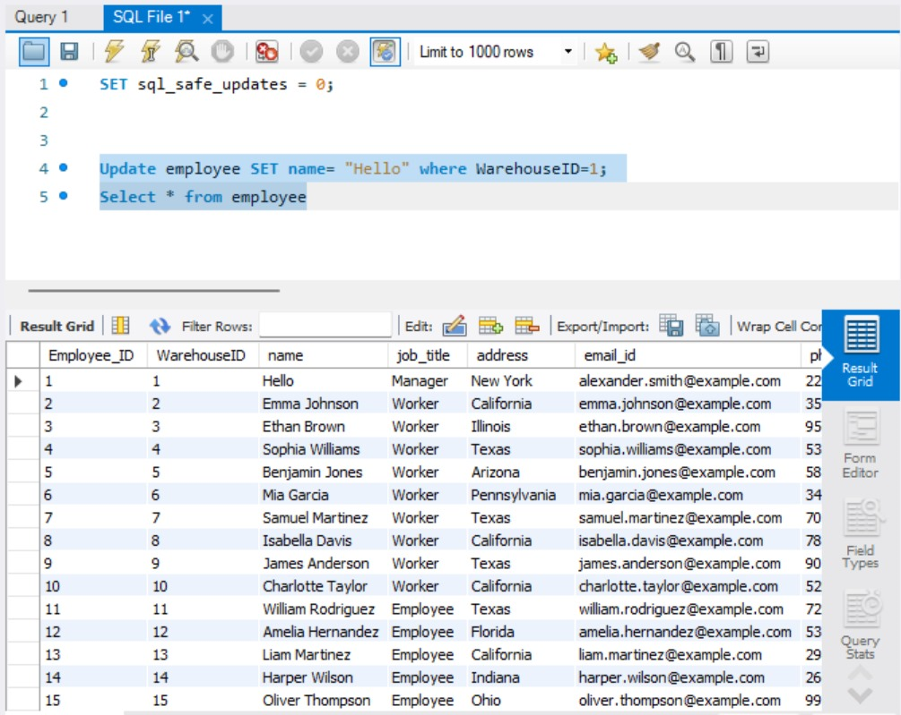
SQL Queries
We used “Select*” query for reading/retrieving all the data present in the employee table
“Update” query is used for modifying the existing table data example. Updating name to "Hello" where WarehouseID = 1

Slide 18
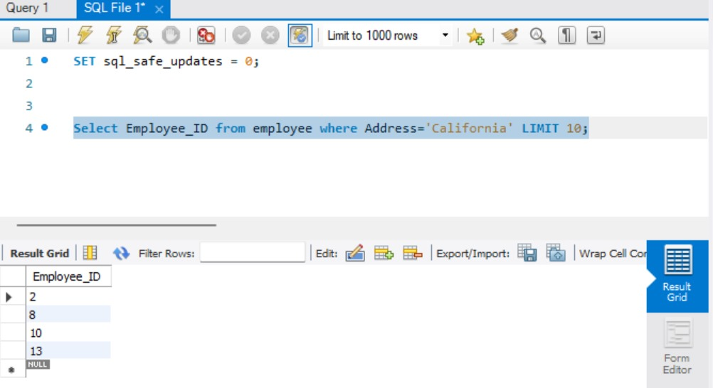
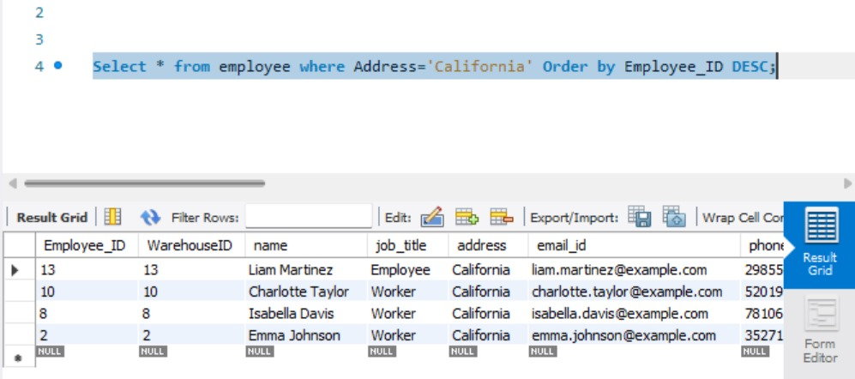
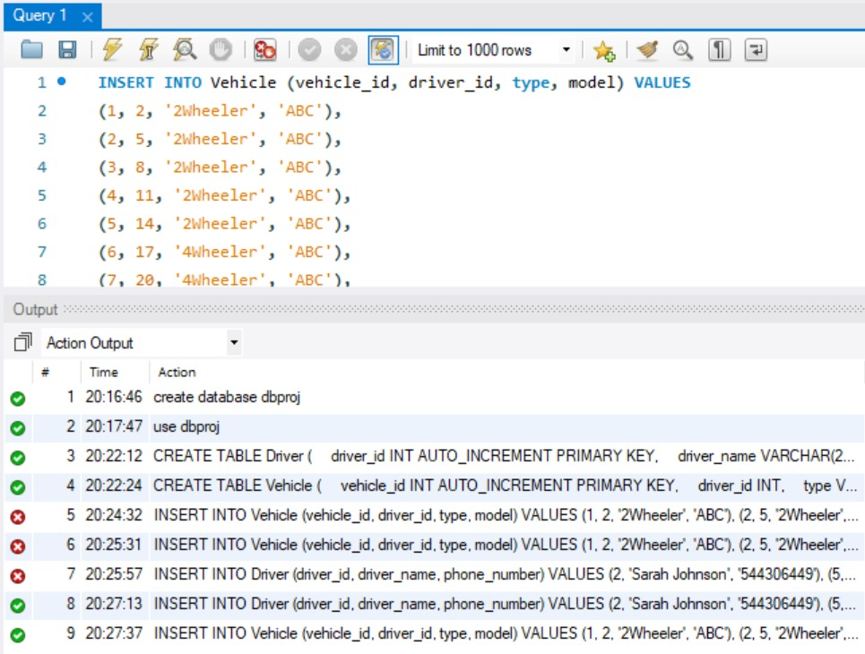
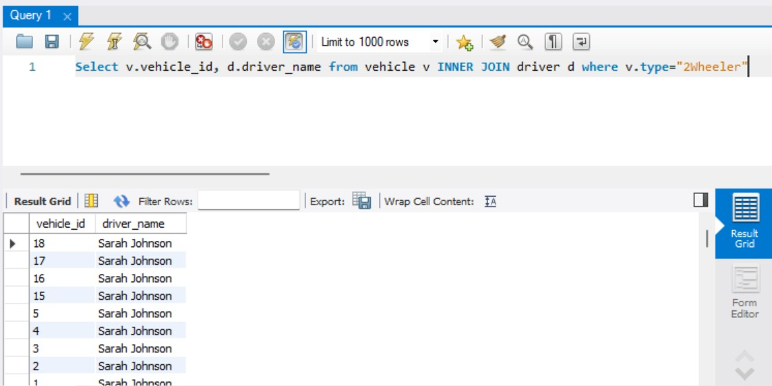
SQL Queries
Limiting the number of record from the table
Ordering the table employee in a descending manner where Address = "California"
Insert data into the table
Inner Join Command

Slide 19
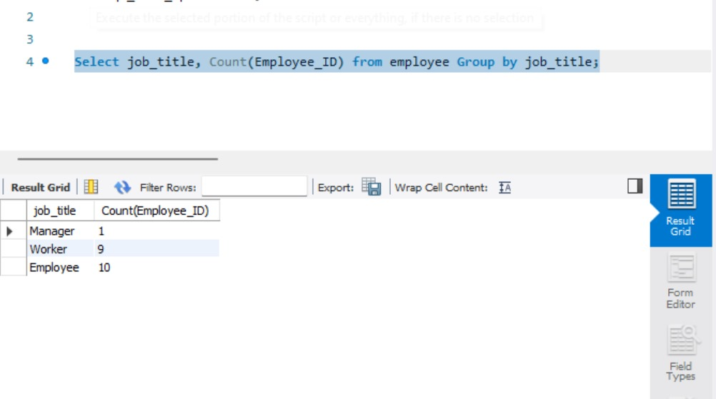
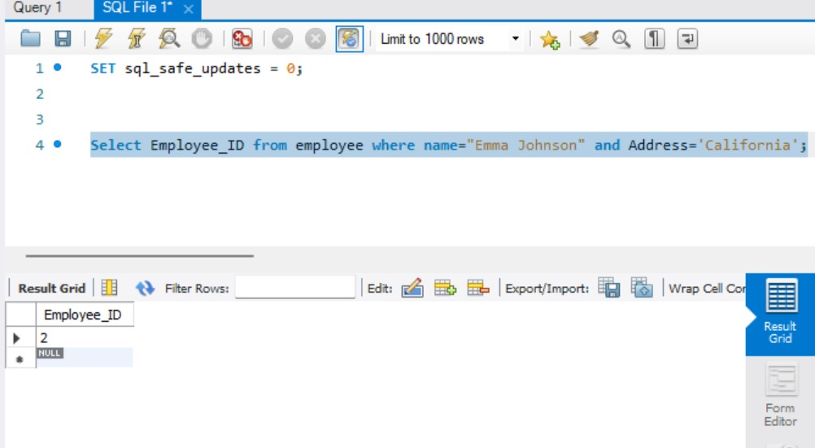
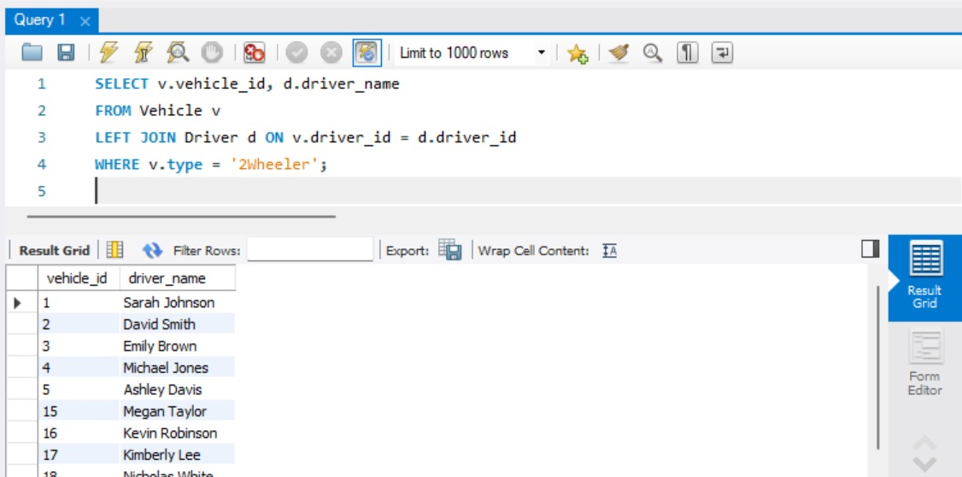
SQL Queries
Grouping the table and providing the count in each grp
Filtering the column based on the condition given in Name and Address
Left Join Command
Order Command

Slide 20


SQL Queries
Group By Command
Update Command

Slide 21
Thank You!

